Slide 1
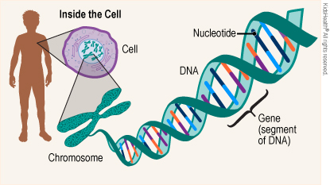
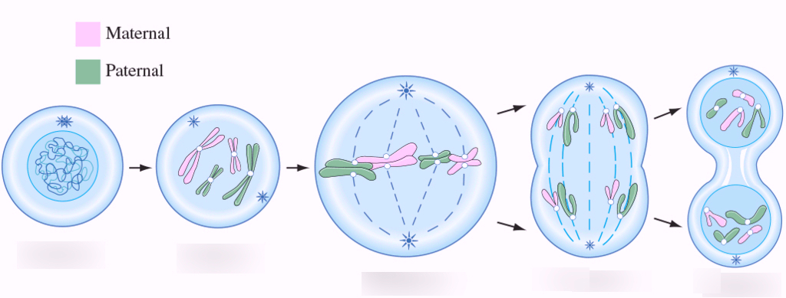
Year 10 Biology Revision
Name: _______________________________
DNA
Q1: What does DNA stand for? ____________________________________________
Q2: Name the four bases: A__________________ C_____________________
T__________________ G_____________________
Q3: Name the items labelled in the diagram:
Q4: What are the three parts of a nucleotide?
S__________________ P_____________________ B_________________
Q5: In a certain gene in an organism, 20% of the nitrogenous bases are adenine. How many are guanine? Justify your answer.
Answer _________________
Justification ________________________________________________________________
_____________________________________________________________________________
(1)
(4)
(4)
D
A _______________________
B _______________________
C DNA
D _______________________
E _____________________
A
C
E
B
(3)
(2)
Mitosis and Meiosis
Q6: How many chromosomes in a diploid human cell? ______________
Q7: What is the purpose of mitosis? _____________________________________________________
Q8: Meiosis creates gametes. What are the male and female gametes called?
_______________________________ ___________________________
Q9: What is the difference between cells created by mitosis and cells created by meiosis?
_________________________________________________________________________________
Q10: Match the stage of cell division with its picture:
Q11: Complete the sentences: parent haploid diploid chromosome four two identical unique six
Mitosis creates ___________ cells. In mitosis, a parent cell splits into _____ ____________ daughter cells. Meiosis creates __________ cells. In meiosis, a parent cell splits into ________
____________ daughter cells.
(1)
(1)
(2)
(1)
Prophase Metaphase Anaphase Telophase
(4)
____________
Interphase
____________
____________
____________
(3)

Slide 2
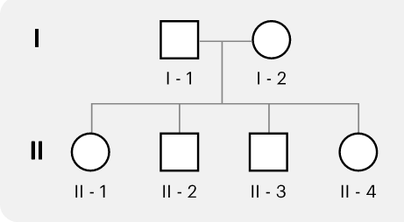
Inheritance
In guinea pigs, red eyes (R) is dominant over black eyes (r).
Q12: What is the phenotype of a guinea pig with the genotype: Rr _________________
rr _________________
Q13: A black-eyed female mated with a homozygous dominant male guinea pig.
What is the genotype of the female? _____________
What is the genotype of the male? _____________
Complete the Punnett Square.
What is the probability that their offspring would have black eyes?
_______________________________________
(1)
(1)
(5)
Sex-linkage and Pedigrees
Q14: What are the sex chromosomes of a typical human female? ___________
Q15: Sex-chromosomes are also known as autosomes. True or False? ___________
Q16: Explain why males are more susceptible to sex-linked traits than females?
_________________________________________________________________________________
_________________________________________________________________________________
Q17: Haemophilia is a sex-linked recessive trait. A female carrier mated with a non-affected male.
What is the genotype of the female? _______________
What is the genotype of the male? _______________
Complete the Punnett Square
What is the probability that their son would have haemophilia? _________
What is the probability that their daughter would have haemophilia? _____
Q18: A geneticist studying haemophilia created this pedigree.
What does a circle represent? _____________
Which individuals are affected by haemophilia? __________________
Individual I-2 is a carrier for haemophilia. How do we know that?
_________________________________________________________
(1)
(1)
(2)
(6)
(3)
Topic | My score | Total | Percentage
DNA |  | 14
Mitosis and meiosis |  | 12
Inheritance |  | 7
Sex-linked traits and pedigree |  | 13
Total |  | 46

